Slide 2
Mean = Average = Typical representation of something

Slide 3
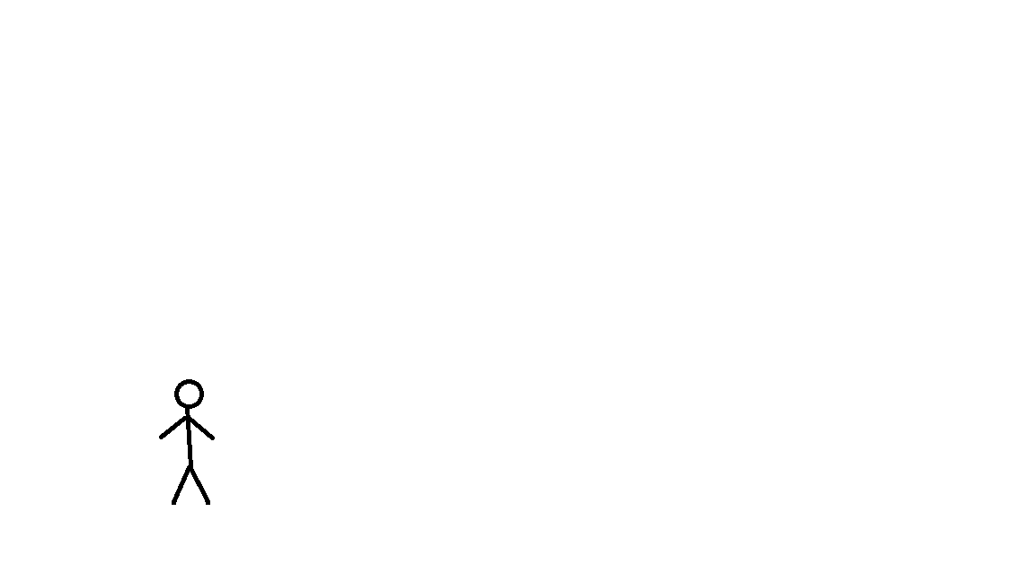
Mean = Average = Typical representation of something

Slide 4
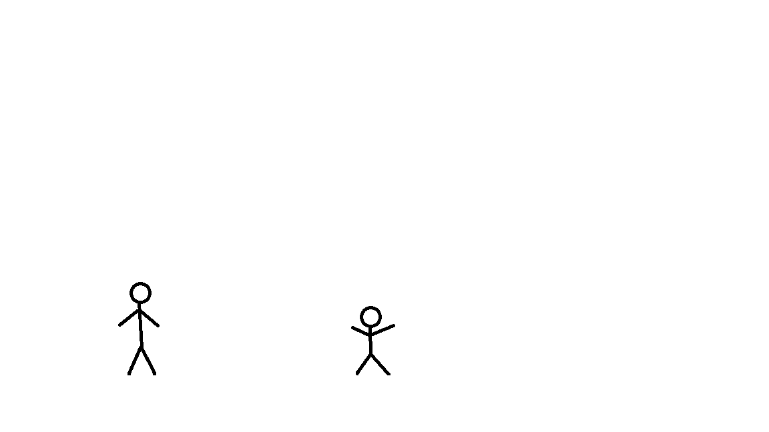
Mean = Average = Typical representation of something

Slide 5
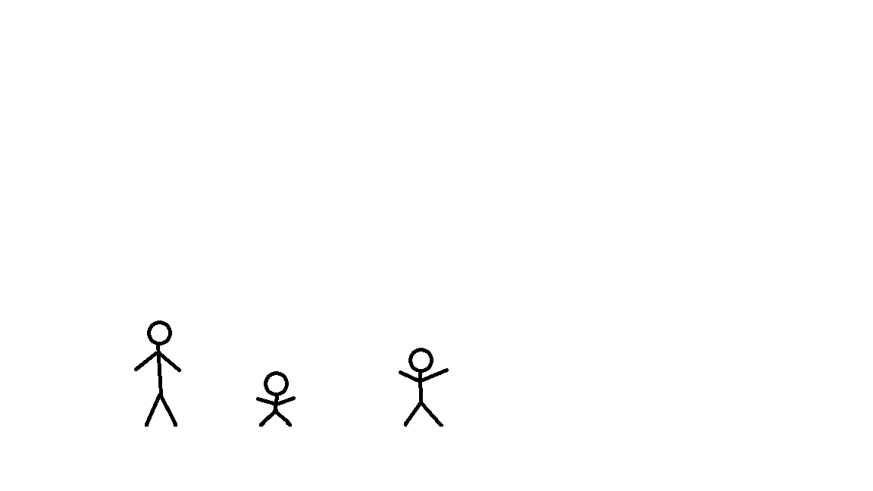
Mean = Average = Typical representation of something

Slide 6
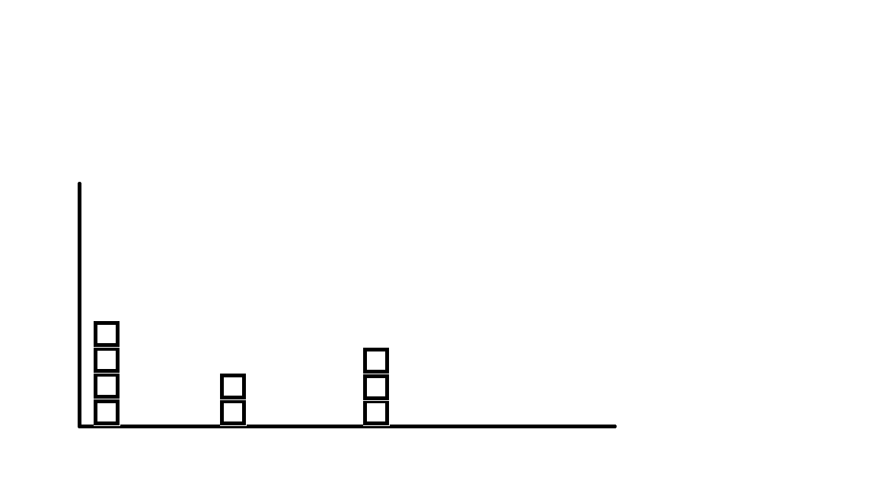

Slide 7
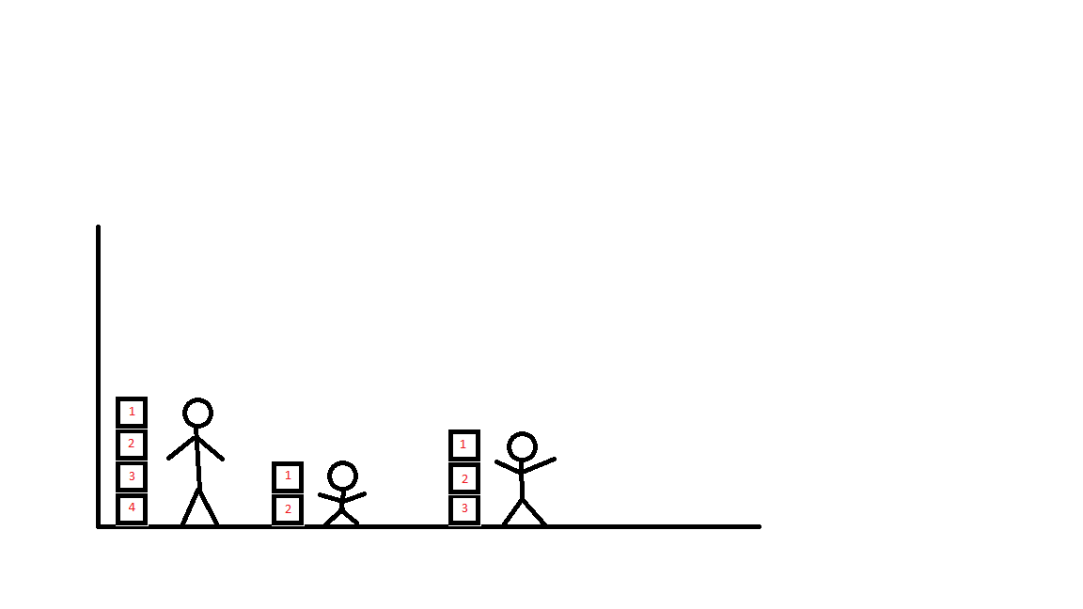
1 2 3

Slide 8
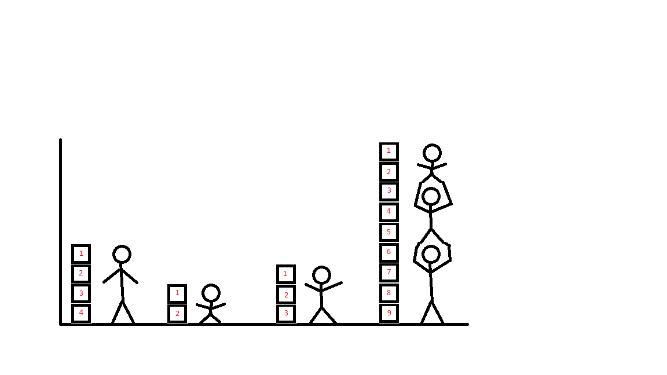
1 2 3

Slide 9
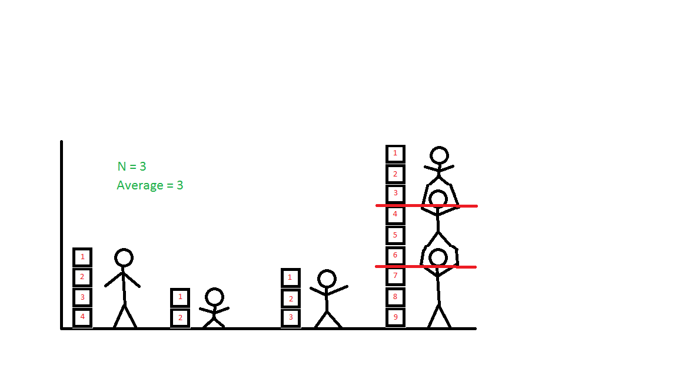
N = 3
Average = 3
1 2 3

Slide 10
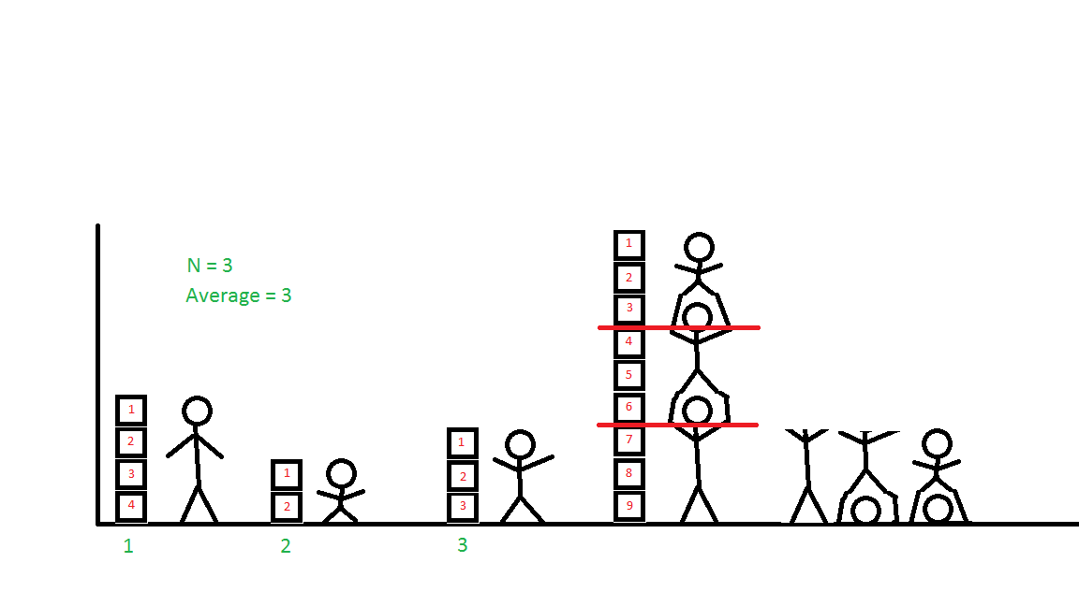
N = 3
Average = 3
1 2 3

Slide 11
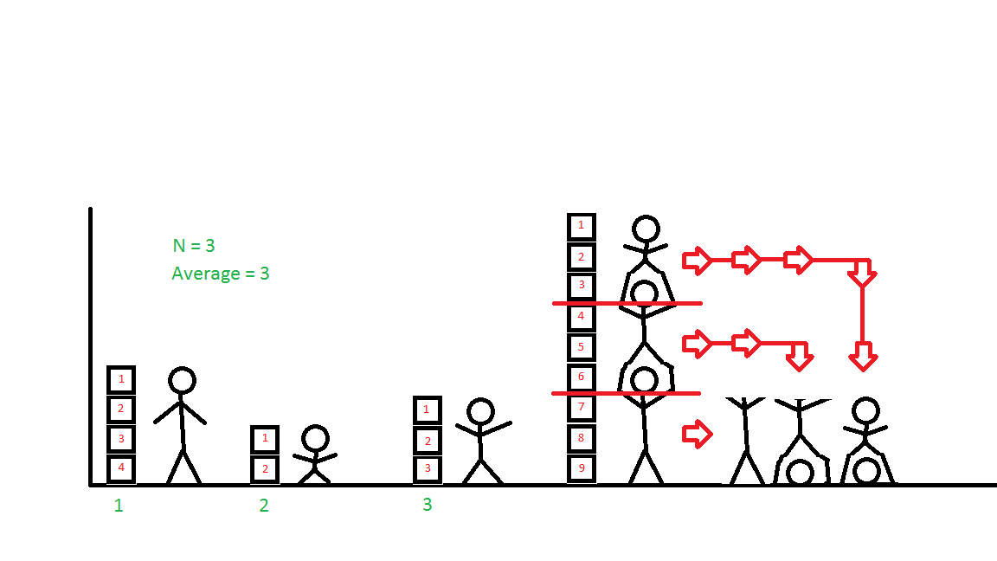
N = 3
Average = 3
1 2 3

Slide 12
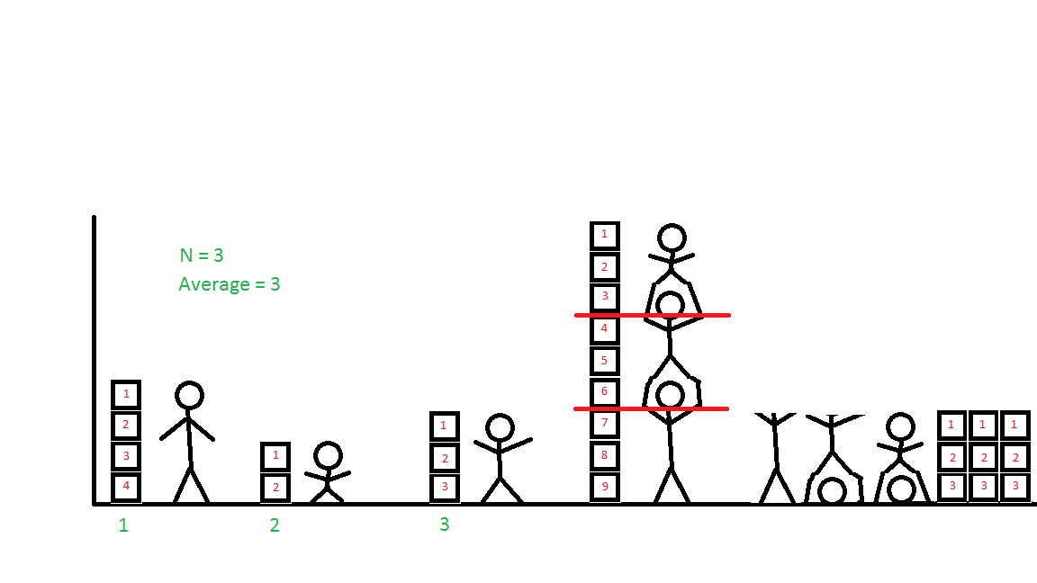
N = 3
Average = 3
1 2 3

Slide 13
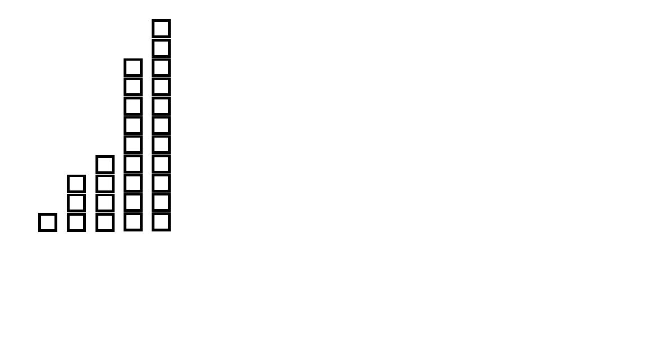

Slide 14
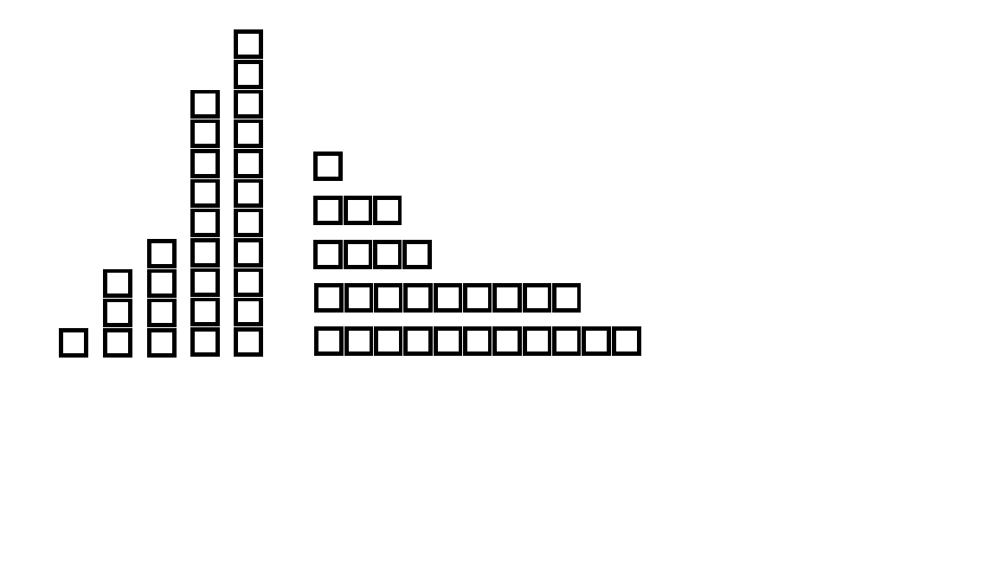

Slide 15
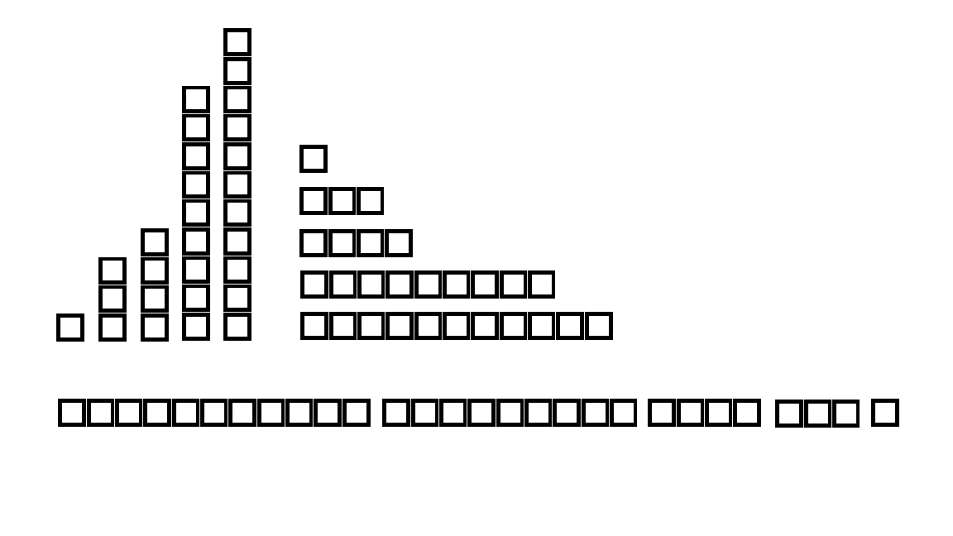

Slide 16
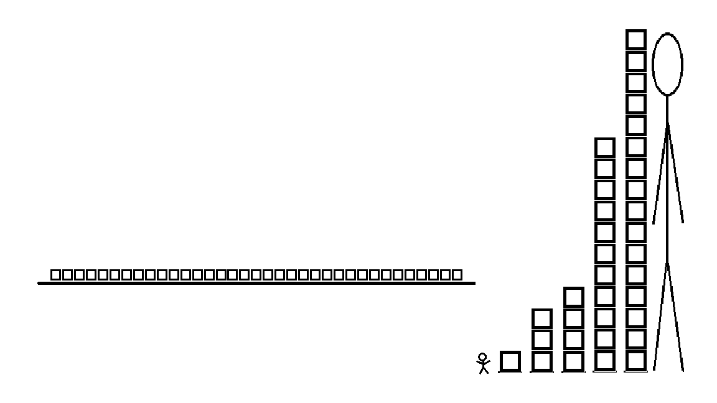
N = 5
0 1 2 3 4 5 6 7 8 9 10 11 12 13 14 15 16 17 18 19 20 21 22 23 24 25 26 27 28 29 30 31 32 33 34 35

Slide 17
N = 5
X = { 1, 3, 4, 11, 16 }
0 1 2 3 4 5 6 7 8 9 10 11 12 13 14 15 16 17 18 19 20 21 22 23 24 25 26 27 28 29 30 31 32 33 34 35

Slide 18
(16)
N = 5
X = { 1, 3, 4, 11, 16 }
16
15
14
13
12
11
10
9
8
7
6
5
4
3
2
1
0
(11)
Height
(4)
0 1 2 3 4 5 6 7 8 9 10 11 12 13 14 15 16 17 18 19 20 21 22 23 24 25 26 27 28 29 30 31 32 33 34 35
(3)
(1)
1 2 3 4 5
Merna’s

Slide 19
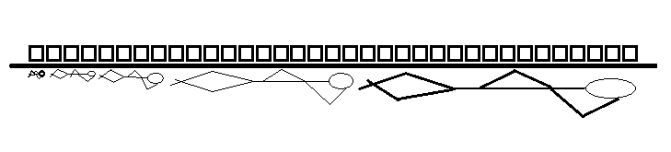
(16)
N = 5
X = { 1, 3, 4, 11, 16 }
16
15
14
13
12
11
10
9
8
7
6
5
4
3
2
1
0
(11)
Height
(4)
0 1 2 3 4 5 6 7 8 9 10 11 12 13 14 15 16 17 18 19 20 21 22 23 24 25 26 27 28 29 30 31 32 33 34 35
(3)
(1)
1 2 3 4 5
Merna’s

Slide 20
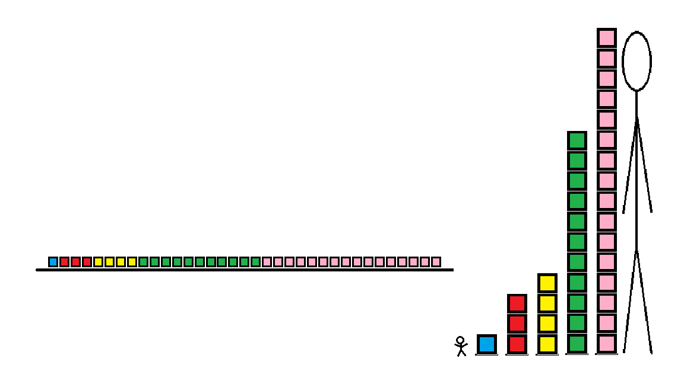
(16)
N = 5
X = { 1, 3, 4, 11, 16 }
16
15
14
13
12
11
10
9
8
7
6
5
4
3
2
1
0
(11)
Height
(4)
0 1 2 3 4 5 6 7 8 9 10 11 12 13 14 15 16 17 18 19 20 21 22 23 24 25 26 27 28 29 30 31 32 33 34 35
(3)
(1)
1 2 3 4 5
Merna’s

Slide 21
(16)
N = 5
X = { 1, 3, 4, 11, 16 }
∑ 1 + 3 + 4 + 11 + 16 = 35
16
15
14
13
12
11
10
9
8
7
6
5
4
3
2
1
0
(11)
Height
1 2 3 4 5
(4)
0 1 2 3 4 5 6 7 8 9 10 11 12 13 14 15 16 17 18 19 20 21 22 23 24 25 26 27 28 29 30 31 32 33 34 35
(3)
(1)
1 2 3 4 5
Merna’s

Slide 22
(16)
N = 5
X = { 1, 3, 4, 11, 16 }
Average =
∑ 1 + 3 + 4 + 11 + 16 = 35
16
15
14
13
12
11
10
9
8
7
6
5
4
3
2
1
0
(11)
Height
1 2 3 4 5
(4)
0 1 2 3 4 5 6 7 8 9 10 11 12 13 14 15 16 17 18 19 20 21 22 23 24 25 26 27 28 29 30 31 32 33 34 35
(3)
(1)
1 2 3 4 5
Merna’s

Slide 23
(16)
N = 5
X = { 1, 3, 4, 11, 16 }
Average = 1 + 3 + 4 +11 + 16
5
∑ 1 + 3 + 4 + 11 + 16 = 35
16
15
14
13
12
11
10
9
8
7
6
5
4
3
2
1
0
35
5
=
=
7
(11)
Height
1 2 3 4 5
(4)
0 1 2 3 4 5 6 7 8 9 10 11 12 13 14 15 16 17 18 19 20 21 22 23 24 25 26 27 28 29 30 31 32 33 34 35
(3)
(1)
1 2 3 4 5
Merna’s

Slide 24
(16)
N = 5
X = { 1, 3, 4, 11, 16 }
Average = 1 + 3 + 4 +11 + 16
5
16
15
14
13
12
11
10
9
8
7
6
5
4
3
2
1
0
35
5
=
=
7
(11)
Height
7
1 2 3 4 5
(4)
0 1 2 3 4 5 6 7 8 9 10 11 12 13 14 15 16 17 18 19 20 21 22 23 24 25 26 27 28 29 30 31 32 33 34 35
(3)
(1)
1 2 3 4 5
Merna’s

Slide 25
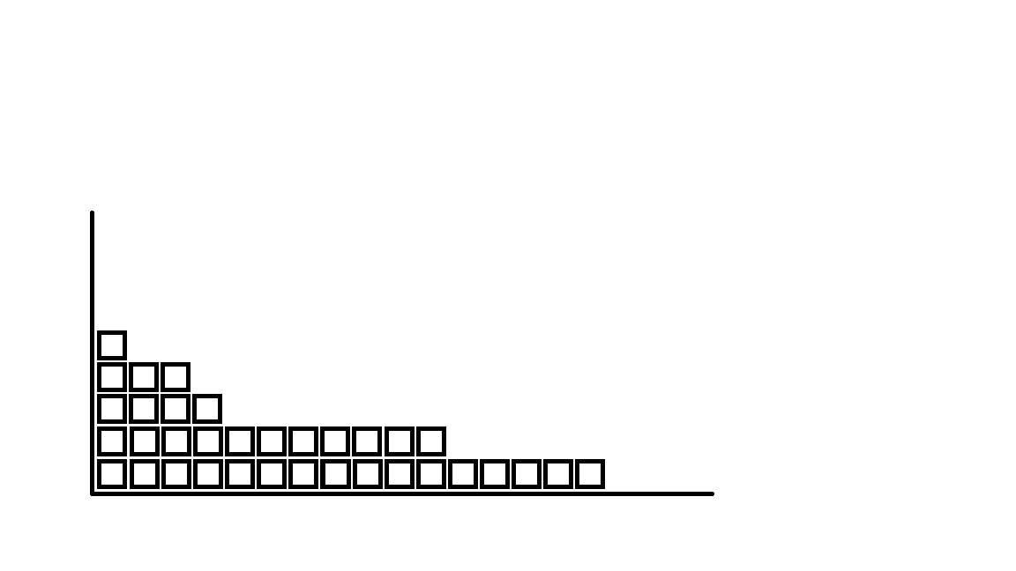
(16)
N = 5
X = { 1, 3, 4, 11, 16 }
Average = 1 + 3 + 4 +11 + 16
5
Average is the typical representation of the group.
N = 5
X = { 1, 3, 4, 11, 16 }
35
5
=
=
7
(11)
1 2 3 4 5
(4)
0 1 2 3 4 5 6 7 8 9 10 11 12 13 14 15 16 17 18 19 20 21 22 23 24 25 26 27 28 29 30 31 32 33 34 35
(3)
(1)
0 1 2 3 4 5 6 7 8 9 10 11 12 13 14 15 16
1 2 3 4 5

Slide 26
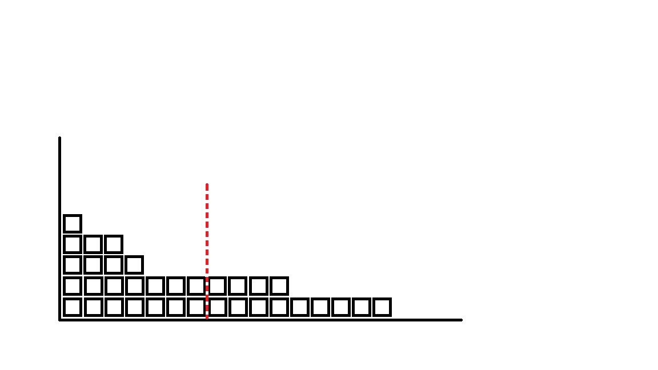
(16)
N = 5
X = { 1, 3, 4, 11, 16 }
Average = 1 + 3 + 4 +11 + 16
5
Average is the typical representation of the group.
N = 5
X = { 1, 3, 4, 11, 16 }
Average = 7
35
5
=
=
7
(11)
1 2 3 4 5
(4)
0 1 2 3 4 5 6 7 8 9 10 11 12 13 14 15 16 17 18 19 20 21 22 23 24 25 26 27 28 29 30 31 32 33 34 35
(3)
(1)
0 1 2 3 4 5 6 7 8 9 10 11 12 13 14 15 16
1 2 3 4 5

Slide 27
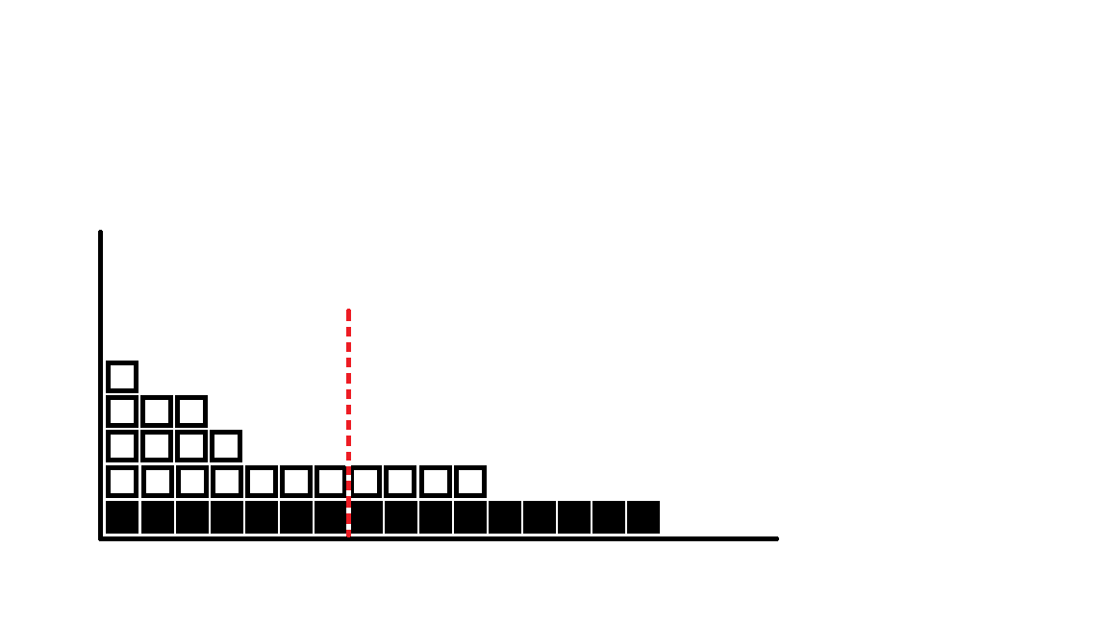
(16)
N = 5
X = { 1, 3, 4, 11, 16 }
Average = 1 + 3 + 4 +11 + 16
5
Average is the typical representation of the group.
N = 5
X = { 1, 3, 4, 11, 16 }
Average = 7
35
5
=
=
7
(11)
1 2 3 4 5
(4)
0 1 2 3 4 5 6 7 8 9 10 11 12 13 14 15 16 17 18 19 20 21 22 23 24 25 26 27 28 29 30 31 32 33 34 35
(3)
(1)
0 1 2 3 4 5 6 7 8 9 10 11 12 13 14 15 16
1 2 3 4 5

Slide 28
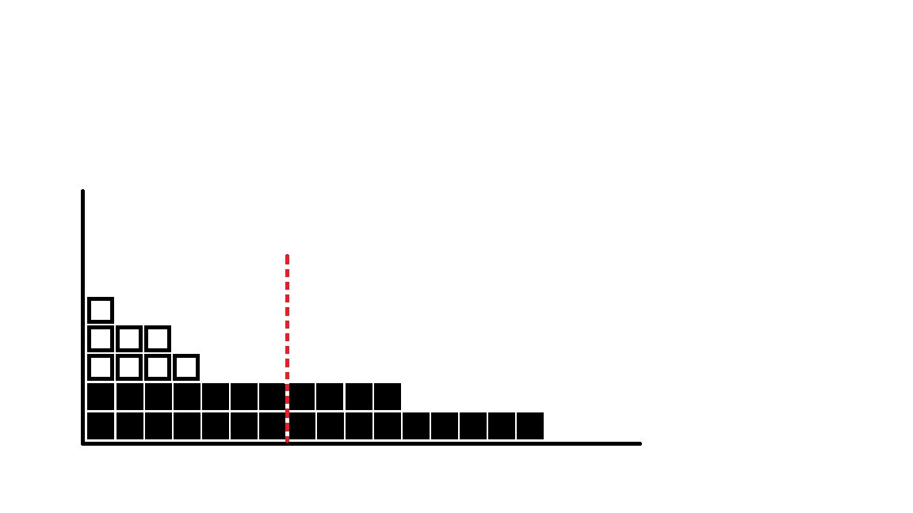
(16)
N = 5
X = { 1, 3, 4, 11, 16 }
Average = 1 + 3 + 4 +11 + 16
5
Average is the typical representation of the group.
N = 5
X = { 1, 3, 4, 11, 16 }
Average = 7
35
5
=
=
7
(11)
1 2 3 4 5
(4)
0 1 2 3 4 5 6 7 8 9 10 11 12 13 14 15 16 17 18 19 20 21 22 23 24 25 26 27 28 29 30 31 32 33 34 35
(3)
(1)
0 1 2 3 4 5 6 7 8 9 10 11 12 13 14 15 16
1 2 3 4 5

Slide 29
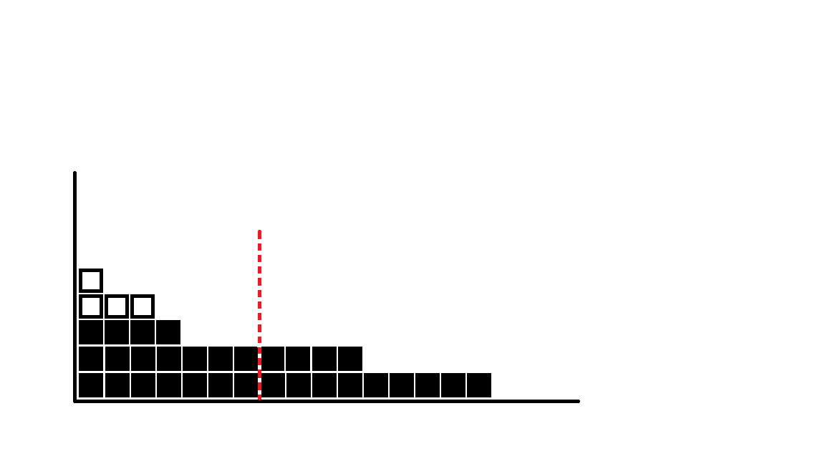
(16)
N = 5
X = { 1, 3, 4, 11, 16 }
Average = 1 + 3 + 4 +11 + 16
5
Average is the typical representation of the group.
N = 5
X = { 1, 3, 4, 11, 16 }
Average = 7
35
5
=
=
7
(11)
1 2 3 4 5
(4)
0 1 2 3 4 5 6 7 8 9 10 11 12 13 14 15 16 17 18 19 20 21 22 23 24 25 26 27 28 29 30 31 32 33 34 35
(3)
(1)
0 1 2 3 4 5 6 7 8 9 10 11 12 13 14 15 16
1 2 3 4 5

Slide 30
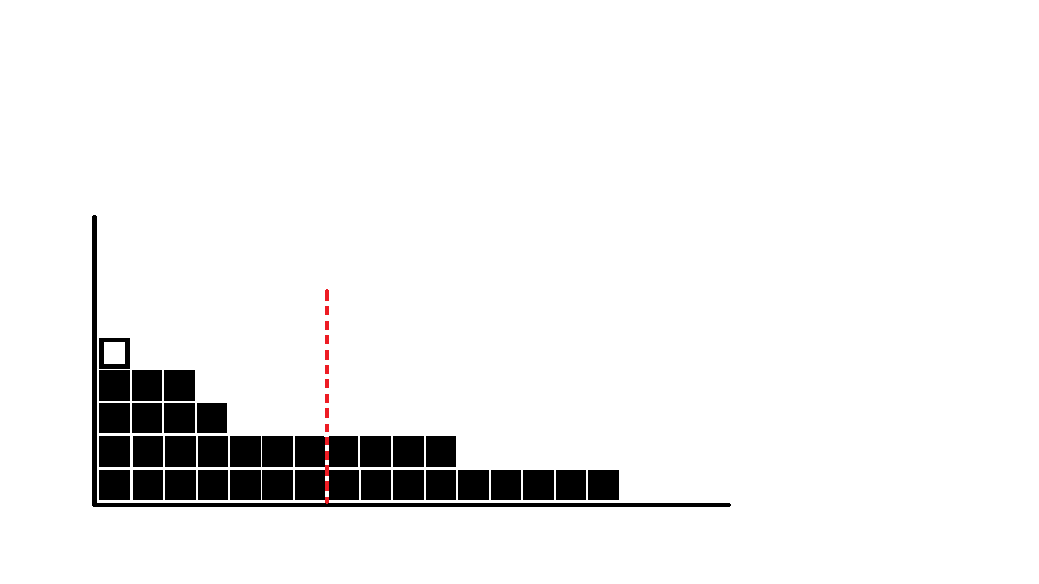
(16)
N = 5
X = { 1, 3, 4, 11, 16 }
Average = 1 + 3 + 4 +11 + 16
5
Average is the typical representation of the group.
N = 5
X = { 1, 3, 4, 11, 16 }
Average = 7
35
5
=
=
7
(11)
1 2 3 4 5
(4)
0 1 2 3 4 5 6 7 8 9 10 11 12 13 14 15 16 17 18 19 20 21 22 23 24 25 26 27 28 29 30 31 32 33 34 35
(3)
(1)
0 1 2 3 4 5 6 7 8 9 10 11 12 13 14 15 16
1 2 3 4 5

Slide 31

(16)
N = 5
X = { 1, 3, 4, 11, 16 }
Average = 1 + 3 + 4 +11 + 16
5
Average is the typical representation of the group.
N = 5
X = { 1, 3, 4, 11, 16 }
Average = 7
35
5
=
=
7
(11)
1 2 3 4 5
(4)
0 1 2 3 4 5 6 7 8 9 10 11 12 13 14 15 16 17 18 19 20 21 22 23 24 25 26 27 28 29 30 31 32 33 34 35
(3)
(1)
0 1 2 3 4 5 6 7 8 9 10 11 12 13 14 15 16
1 2 3 4 5

Slide 32
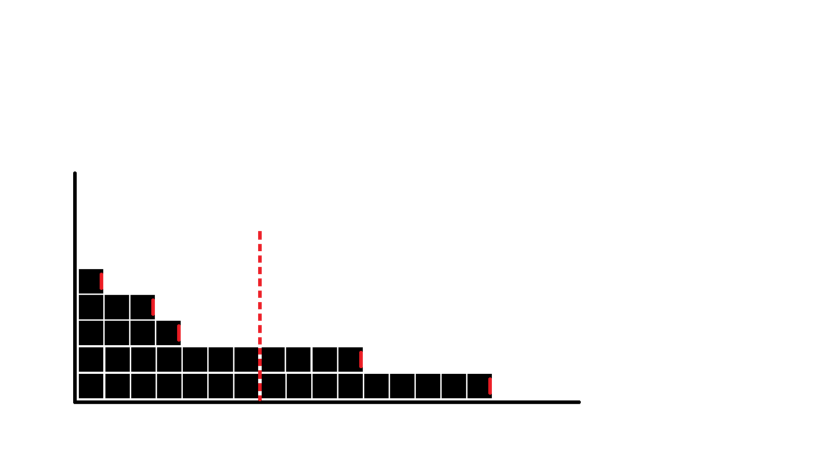
(16)
N = 5
X = { 1, 3, 4, 11, 16 }
Average = 1 + 3 + 4 +11 + 16
5
Average is the typical representation of the group.
Deviation is how much a value varies from another value.
N = 5
X = { 1, 3, 4, 11, 16 }
Average = 7
35
5
=
=
7
(11)
(-)
Mean
(Average)
(+)
-6
1 - 7 = -6
3 - 7 = -4
4 - 7 = -3
11 - 7 = 4
16 - 7 = 9
-4
1 2 3 4 5
(4)
-3
(3)
0 1 2 3 4 5 6 7 8 9 10 11 12 13 14 15 16 17 18 19 20 21 22 23 24 25 26 27 28 29 30 31 32 33 34 35
4
9
(1)
0 1 2 3 4 5 6 7 8 9 10 11 12 13 14 15 16
1 2 3 4 5

Slide 33
(16)
N = 5
X = { 1, 3, 4, 11, 16 }
Average = 1 + 3 + 4 +11 + 16
5
Average is the typical representation of the group.
Deviation is how much a value varies from another value.
Average Deviation is, well, the average of the sum of deviations.
N = 5
X = { 1, 3, 4, 11, 16 }
Average = 7
35
5
=
=
7
(11)
(-)
Mean
(Average)
(+)
Average Deviation = -6 -4 -3 +4 +9
5
0
5
0
=
=
-6 -4 -3 = -13
4 +9 = 13
-6
1 - 7 = -6
3 - 7 = -4
4 - 7 = -3
11 - 7 = 4
16 - 7 = 9
0
-4
1 2 3 4 5
(4)
-3
(3)
0 1 2 3 4 5 6 7 8 9 10 11 12 13 14 15 16 17 18 19 20 21 22 23 24 25 26 27 28 29 30 31 32 33 34 35
4
9
(1)
0 1 2 3 4 5 6 7 8 9 10 11 12 13 14 15 16
1 2 3 4 5

Slide 34
(16)
N = 5
X = { 1, 3, 4, 11, 16 }
Average = 1 + 3 + 4 +11 + 16
5
Average is the typical representation of the group.
Deviation is how much a value varies from another value.
Average Deviation is, well, the average of the sum of deviations.
N = 5
X = { 1, 3, 4, 11, 16 }
Average = 7
35
5
=
=
7
(11)
(-)
Mean
(Average)
(+)
Average Deviation = -6 -4 -3 +4 +9
5
0
5
0
=
=
-6 -4 -3 = -13
4 +9 = 13
-6
1 - 7 = -6
3 - 7 = -4
4 - 7 = -3
11 - 7 = 4
16 - 7 = 9
0
-4
1 2 3 4 5
(4)
-3
(3)
0 1 2 3 4 5 6 7 8 9 10 11 12 13 14 15 16 17 18 19 20 21 22 23 24 25 26 27 28 29 30 31 32 33 34 35
4
9
(1)
0 1 2 3 4 5 6 7 8 9 10 11 12 13 14 15 16
1 2 3 4 5

Slide 35
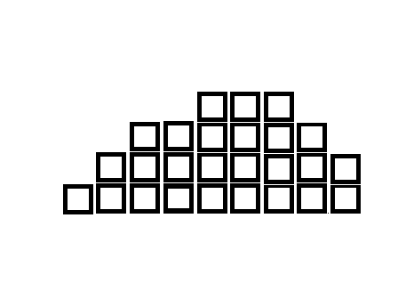
Average Deviation = -6 -4 -3 +4 +9 0
5
= 0
=
5
26

Slide 36
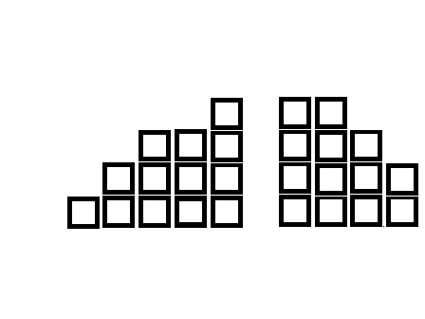
Average Deviation = -6 -4 -3 +4 +9 0
5
= 0
=
5
Because it is how we are manipulating the numbers.
Any time you divide something in half, half will fall on onside of the average, half on the other side.
The average is larger than one half and smaller than one half.
When you take the average away from the smaller half you will have a negative number. When you take the average away from the larger half you will have a positive number.
Average
$$\frac{1}{2}$$
$$\frac{1}{2}$$
(-)
(+)
-13
13
13

Slide 37
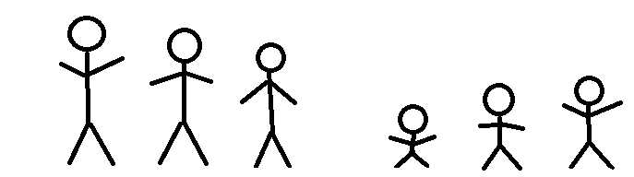
Average Deviation = -6 -4 -3 +4 +9 0
5
= 0
=
5
Because it is how we are manipulating the numbers.
Any time you divide something in half, half will fall on onside of the average, half on the other side.
The average is larger than one half and smaller than one half.
When you take the average away from the smaller half you will have a negative number. When you take the average away from the larger half you will have a positive number.
Average
$$\frac{1}{2}$$
$$\frac{1}{2}$$
(-)
(+)
-13
13
13

Slide 38
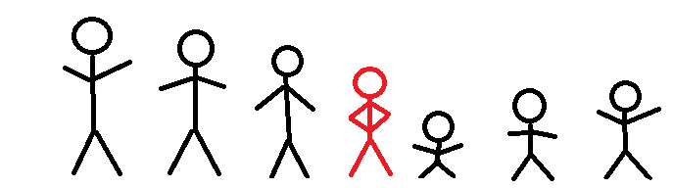
Average Deviation = -6 -4 -3 +4 +9 0
5
= 0
=
5
Because it is how we are manipulating the numbers.
Any time you divide something in half, half will fall on onside of the average, half on the other side.
The average is larger than one half and smaller than one half.
When you take the average away from the smaller half you will have a negative number. When you take the average away from the larger half you will have a positive number.
Average
$$\frac{1}{2}$$
$$\frac{1}{2}$$
(-)
(+)
-13
13
13

Slide 39
So what if we use the absolute value? It would put all of our numbers on the positive side of the number line and not cancel each other out!
1 - 7 = -6 = 6
3 - 7 = -4 = 4
4 - 7 = -3 = 3
11 - 7 = 4 = 4
16 - 7 = 9 = 9
26
26/5 = 5.2

Slide 40
So what if we use the absolute value? It would put all of our numbers on the positive side of the number line and not cancel each other out!
1 - 7 = -6 = 6
3 - 7 = -4 = 4
4 - 7 = -3 = 3
11 - 7 = 4 = 4
16 - 7 = 9 = 9
26
26/5 = 5.2

Slide 41
So what if we use the absolute value? It would put all of our numbers on the positive side of the number line and not cancel each other out!
1 - 7 = -6 = 6
3 - 7 = -4 = 4
4 - 7 = -3 = 3
11 - 7 = 4 = 4
16 - 7 = 9 = 9
26
26/5 = 5.2

Slide 42
So what if we use the absolute value? It would put all of our numbers on the positive side of the number line and not cancel each other out!
Sum of Squares = the mean is subtracted from each value, squared, and then added together.
1 - 7 = -6 = 6
3 - 7 = -4 = 4
4 - 7 = -3 = 3
11 - 7 = 4 = 4
16 - 7 = 9 = 9
26
26/5 = 5.2

Slide 43
So what if we use the absolute value? It would put all of our numbers on the positive side of the number line and not cancel each other out!
Sum of Squares = the mean is subtracted from each value, squared, and then added together.
1 - 7 = -6 = 6
3 - 7 = -4 = 4
4 - 7 = -3 = 3
11 - 7 = 4 = 4
16 - 7 = 9 = 9
26
(1 - 7)² = (-6)² = 36
(3 - 7)² = (-4)² = 16
(4 - 7)² = (-3)² = 9
(11 - 7)² = (4)² = 16
(16 - 7)² = (9)² = 81
158
26/5 = 5.2

Slide 44
So what if we use the absolute value? It would put all of our numbers on the positive side of the number line and not cancel each other out!
Sum of Squares = the mean is subtracted from each value, squared, and then added together.
1 - 7 = -6 = 6
3 - 7 = -4 = 4
4 - 7 = -3 = 3
11 - 7 = 4 = 4
16 - 7 = 9 = 9
26
(1 - 7)² = (-6)² = 36
(3 - 7)² = (-4)² = 16
(4 - 7)² = (-3)² = 9
(11 - 7)² = (4)² = 16
(16 - 7)² = (9)² = 81
158
Sum of Squares (SS)
26/5 = 5.2

Slide 45
So what if we use the absolute value? It would put all of our numbers on the positive side of the number line and not cancel each other out!
Sum of Squares = the mean is subtracted from each value, squared, and then added together.
1 - 7 = -6 = 6
3 - 7 = -4 = 4
4 - 7 = -3 = 3
11 - 7 = 4 = 4
16 - 7 = 9 = 9
26
(1 - 7)² = (-6)² = 36
(3 - 7)² = (-4)² = 16
(4 - 7)² = (-3)² = 9
(11 - 7)² = (4)² = 16
(16 - 7)² = (9)² = 81
158
Sum of Squares (SS)
26/5 = 5.2
158/5 = 31.6

Slide 46
So what if we use the absolute value? It would put all of our numbers on the positive side of the number line and not cancel each other out!
Sum of Squares = the mean is subtracted from each value, squared, and then added together.
Variance = the average of the square differences from the mean.
1 - 7 = -6 = 6
3 - 7 = -4 = 4
4 - 7 = -3 = 3
11 - 7 = 4 = 4
16 - 7 = 9 = 9
26
(1 - 7)² = (-6)² = 36
(3 - 7)² = (-4)² = 16
(4 - 7)² = (-3)² = 9
(11 - 7)² = (4)² = 16
(16 - 7)² = (9)² = 81
158
Sum of Squares (SS)
26/5 = 5.2
158/5 = 31.6
Variance

Slide 47
Sum of Squares = the mean is subtracted from each value, squared, and then added together.
(1 - 7)² = (-6)² = 36
(3 - 7)² = (-4)² = 16
(4 - 7)² = (-3)² = 9
(11 - 7)² = (4)² = 16
(16 - 7)² = (9)² = 81
158
The sum of (+)

Slide 48
Sum of Squares = the mean is subtracted from each value, squared, and then added together.
The squared averages
(1 - 7)² = (-6)² = 36
(3 - 7)² = (-4)² = 16
(4 - 7)² = (-3)² = 9
(11 - 7)² = (4)² = 16
(16 - 7)² = (9)² = 81
158
The sum of (+)

Slide 49
Sum of Squares = the mean is subtracted from each value, squared, and then added together.
The squared averages
(1 - 7)² = (-6)² = 36
(3 - 7)² = (-4)² = 16
(4 - 7)² = (-3)² = 9
(11 - 7)² = (4)² = 16
(16 - 7)² = (9)² = 81
158
After subtracting the mean from the individual averages
The sum of (+)

Slide 50

Sum of Squares = the mean is subtracted from each value, squared, and then added together.
(1 - 7)² = (-6)² = 36
(3 - 7)² = (-4)² = 16
(4 - 7)² = (-3)² = 9
(11 - 7)² = (4)² = 16
(16 - 7)² = (9)² = 81
158
Divide the sum by our total number of individuals (5) and we get Variance
$$\frac{158}{5}=31.6$$

Slide 51

Sum of Squares = the mean is subtracted from each value, squared, and then added together.
(1 - 7)² = (-6)² = 36
(3 - 7)² = (-4)² = 16
(4 - 7)² = (-3)² = 9
(11 - 7)² = (4)² = 16
(16 - 7)² = (9)² = 81
158
Standard Deviation = the squared root of the average squared deviation from the mean (variance).
$$\frac{158}{5}=31.6$$
Variance
$\sqrt{31.6 }$ = 5.62

Slide 52
Sum of Squares = the mean is subtracted from each value, squared, and then added together.
(1 - 7)² = (-6)² = 36
(3 - 7)² = (-4)² = 16
(4 - 7)² = (-3)² = 9
(11 - 7)² = (4)² = 16
(16 - 7)² = (9)² = 81
158
The average of the absolute values = 5.2
The average of the sum of squares = 5.62
Standard Deviation = the squared root of the average squared deviation from the mean (variance).
$$\frac{158}{5}=31.6$$
Variance
$\sqrt{31.6 }$ = 5.62

Slide 53
N
5
X
1
3
4
11
16

Slide 54
N
5
X
1
3
4
11
16
Mean
1
3
4
11
+16
35
35/5
= 7

Slide 55
N
5
X
1
3
4
11
16
Mean
1
3
4
11
+16
35
35/5
= 7
Deviance
1 – 7 = -6
3 – 7 = -4
4 – 7 = -3
11 – 7 = 4
16 – 7 = 9

Slide 56
N
5
X
1
3
4
11
16
Mean
1
3
4
11
+16
35
35/5
= 7
Deviance
1 – 7 = -6
3 – 7 = -4
4 – 7 = -3
11 – 7 = 4
16 – 7 = 9
Sum of Squares
(1 - 7)² = (-6)² = 36
(3 - 7)² = (-4)² = 16
(4 - 7)² = (-3)² = 9
(11 - 7)² = (4)² = 16
(16 - 7)² = (9)² = +81
158

Slide 57
N
5
X
1
3
4
11
16
Mean
1
3
4
11
+16
35
35/5
= 7
Deviance
1 – 7 = -6
3 – 7 = -4
4 – 7 = -3
11 – 7 = 4
16 – 7 = 9
Sum of Squares
(1 - 7)² = (-6)² = 36
(3 - 7)² = (-4)² = 16
(4 - 7)² = (-3)² = 9
(11 - 7)² = (4)² = 16
(16 - 7)² = (9)² = +81
158
Variance
158/5 = 31.6

Slide 58
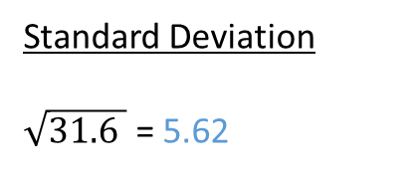
N
5
X
1
3
4
11
16
Mean
1
3
4
11
+16
35
35/5
= 7
Deviance
1 – 7 = -6
3 – 7 = -4
4 – 7 = -3
11 – 7 = 4
16 – 7 = 9
Sum of Squares
(1 - 7)² = (-6)² = 36
(3 - 7)² = (-4)² = 16
(4 - 7)² = (-3)² = 9
(11 - 7)² = (4)² = 16
(16 - 7)² = (9)² = +81
158
Variance
158/5 = 31.6
Standard Deviation
$\sqrt{31.6 }$ = 5.62

